Slide 1


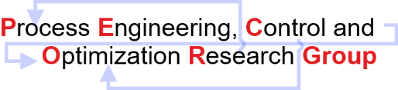
Artificial Neural Network
Model
Discipline of Chemical Engineering,
Indian Institute of Technology Gandhinagar,
Palaj, Gujarat – 382055
India

Slide 2
Artificial Neural Network
Case Study 1
Forward Selection Algorithm implemented on Random Forest Classifier.
Statistical Features obtained after running the forward selection algorithm starting with an empty set of features.
Statistical Features Selected from Forward Selection Algorithm | Corresponding increase in accuracy
MOLD BROAD FACE 2 INLET OUTLET WATER TEMP. DELTA MEAN | 67.23%
SEG 7+8 BOTTOM SECONDARY COOLING WATER FLOW ACTUAL MEAN | 76.47%
PER_S MEAN | 77.31%
MOLD NARROW FACE COOLING WATER INLET TEMP MEAN | 81.51%

Slide 3
Artificial Neural Network
Case Study 2
Forward Selection Algorithm implemented on ANN.
Statistical Features obtained after running the forward selection algorithm starting with an empty set of features.
Statistical Features Selected from Forward Selection Algorithm | Corresponding increase in accuracy
MOLD BROAD FACE 2 INLET OUTLET WATER TEMP. DELTA MEAN | 71.43%
SEG 7+8 BOTTOM SECONDARY COOLING WATER FLOW ACTUAL MEAN | 73.11%

Slide 4
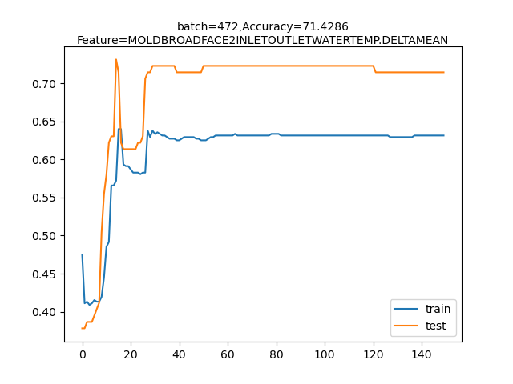
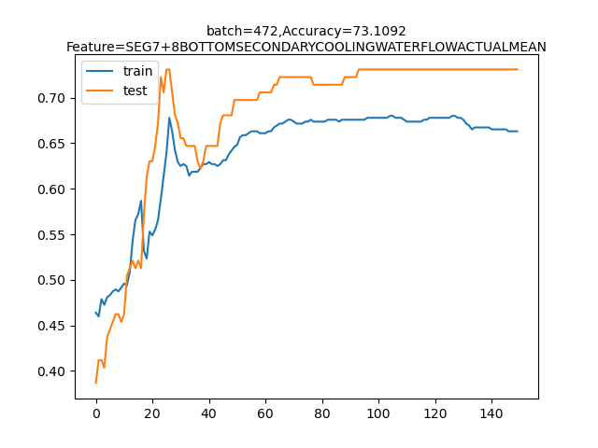
Artificial Neural Network
Case Study 2
Forward Selection Algorithm implemented on ANN.
Stability and Convergence analysis.

Slide 5
Artificial Neural Network
Case Study 3
Forward Selection Algorithm implemented on Random Forest Classifier.
Statistical Features obtained after running the forward selection algorithm starting with an empty set of features.
Statistical Features Selected from Forward Selection Algorithm | Corresponding increase in accuracy
MOLD WIDTH TOP MEAN | 67.2278%
MOLD NARROW FACE COOLING WATER INLET TEMP MEAN | 76.4706%
PER_VC MEAN | 78.1513%
DAYS AFTER CIRCLARD MEAN | 82.3529%
MOLD BROAD FACE COOLING WATER INLET PRESS MEAN | 84.8739%

Slide 6
Artificial Neural Network
Case Study 3
 | Statistical Features Selected from Forward Selection Algorithm | Corresponding increase in accuracy
1 | STEEL LEVEL IN MOLD-SET MEAN | 82.3529%
2 | MOLD BROAD FACE1 INLET OUTLET WATER TEMP. DELTA MEAN | 81.5126%
3 | TUNDISH WEIGHT MEAN | 82.3529%
4 | SEG 7+8 BOTTOM SECONDARY COOLING WATER FLOW ACTUAL MEAN | 79.8319%
5 | DAYS AFTER SHUT DOWN MEAN | 80.6722%
6 | MOLD TAPER PERCENT MEAN | 80.6722%
7 | DAYS AFTER SPRAY CLEANING MEAN | 79.8319%
8 | PER_C MEAN | 79.8319%
9 | STEEL LEVEL IN MOLD-ACT MEAN | 79.8319%
10 | MOLD BROAD FACE COOLING WATER INLET TEMP MEAN | 79.8319%,
11 | BROAD FACE 2 HEAT FLUX MAX | 80.6722%,
12 | TUNDISH TEMPERATURE MEAN | 79.8319%
13 | DAYS AFTER NARROW FACE ALIGNMENT MEAN | 81.5126%

Slide 7
Artificial Neural Network
Case Study 3
 | Statistical Features Selected from Forward Selection Algorithm | Corresponding increase in accuracy
14 | BROAD FACE 2 HEAT FLUX MEAN | 82.3529%
15 | PER_V MEAN | 80.6722%
16 | NARROWFACE1 WATER FLOW MIN | 79.8319%
17 | BROAD FACE1 HEAT FLUX MIN | 81.5126%
18 | TUNDISH TEMPERATURE MIN | 79.8319%
19 | MOLD NARROW FACE2 INLET OUTLET WATER TEMP.DELTA MEAN | 79.8319%
20 | NARROW FACE 2 HEAT FLUX MIN | 82.3529%
21 | SEG0A SECONDARY COOLING WATER PRESSURE ACTUAL MEAN | 81.5126%
22 | MOLD NARROW FACE 1 INLET OUTLET WATER TEMP. DELTA MEAN | 80.6722%
23 | PER_CA MEAN | 79.8319%

Slide 8
Artificial Neural Network
Case Study 4
Forward Selection Algorithm implemented on ANN.
Statistical Features obtained after running the forward selection algorithm starting with an empty set of features.
Statistical Features Selected from Forward Selection Algorithm | Corresponding increase in accuracy
MOLD BROAD FACE 2 INLET OUTLET WATER TEMP. DELTA MEAN | 71.43%
SEG 7+8 BOTTOM SECONDARY COOLING WATER FLOW ACTUAL MEAN | 73.11%

Slide 9
Artificial Neural Network
Case Study 4
 | Statistical Features Selected from Forward Selection Algorithm | Corresponding increase in accuracy
1 | MOLD BROAD FACE 2 INLET OUTLET WATER TEMP. DELTA MEAN | 71.4285%
2 | SEG7+8 BOTTOM SECONDARY COOLING WATER FLOW ACTUAL MEAN | 73.1092%
3 | MOLD WIDTH TOP MEAN | 71.4285%
4 | MOLD BROAD FACE 1 INLET OUTLET WATER TEMP. DELTA MEAN | 72.2689%
5 | TUNDISH WEIGHT MEAN | 71.4285%
6 | NARROW FACE 1 WATER FLOW MEAN | 69.7478%
7 | PER_MN MEAN | 70.5882 %
8 | STRAND DRIVE CURRENT MAX | 69.7478 %
9 | SEG 5+6 TOP SECONDARY COOLING WATER FLOW ACTUAL VARIANCE | 70.5882 %
10 | BROAD FACE1 WATER FLOW VARIANCE | 73.1092 %
11 | NARROW FACE1 WATER FLOW MAX | 71.4285 %
12 | SEG2 BOTTOM SECONDARY COOLING WATER FLOW ACTUAL VARIANCE | 70.5882 %
13 | SEG1 TOP SECONDARY COOLING WATER PRESSURE ACTUAL MEAN | 72.2689 %
14 | SEG1 BOT SECONDARY COOLING WATER FLOW ACTUAL MEAN | 72.2689 %

Slide 10
Artificial Neural Network
Case Study 4
 | Statistical Features Selected from Forward Selection Algorithm | Corresponding increase in accuracy
15 | PER_VN MEAN | 72.2689%
16 | SEG 3+4 BOTTOM SECONDARY COOLING WATER FLOW ACTUAL VARIANCE | 70.5882%
17 | SEG 9+10+11+12 TOP SECONDARY COOLING WATER FLOW SETPOINT VARIANCE | 69.7478 %
18 | MOLD BROAD FACE COOLING WATER INLET PRESS MEAN | 70.5882 %
19 | SEG 7+8 TOP SECONDARY COOLING WATER FLOW SET POINT MEAN | 69.7478%

Slide 11
Artificial Neural Network
Case Study 5
 | Statistical Features Selected from Forward Selection Algorithm Using Random Forest Classifier changing the subset of 5 selected feature by one. Accuracy range (0.79-0.9) | Corresponding increase in accuracy
1 | [MOLD WIDTH TOP MEAN ] | 67.2268%
2 | [ 1, MOLD NARROW FACE COOLING WATER INLET TEMP MEAN] | 76.4705%
3 | [1, 2, PER_VC MEAN] | 78.1512%
4 | [1, 2, 3, DAYS AFTER CIRCLARD MEAN] | 82.3529%
5 | [1, 2, 3, 4, MOLD BROAD FACE COOLING WATER INLET PRESS MEAN] | 84.8739%
6 | [1, 2, 3, 4, 5, STEEL LEVEL IN MOLD-SET MEAN] | 82.3529%
7 | [1,2, 3, 4, 5,6, MOLD BROAD FACE1 INLET OUTLET WATER TEMP.DELTA MEAN] | 82.3529%
8 | [1,2,3,4,5,6, 7,NARROW FACE1 WATER FLOW MEAN] | 80.6722%
9 | [1,2,3,4,5,6,7,8,PER_SIMEAN] | 80.6722%
10 | [1,2,3,4,5,6,7,8,9, SEG 7+8 BOTTOM SECONDARY COOLING WATER FLOW ACTUAL MEAN] | 80.6722%

Slide 12
Artificial Neural Network
Case Study 5
 | Statistical Features Selected from Forward Selection Algorithm Using Random Forest Classifier changing the subset of 5 selected feature by one. Accuracy Range (0.79-0.9) | Corresponding increase in accuracy
11 | [1,2,3,4,5,6,7,8,9, 10, LIQUIDUS TEMP MEAN] | 82.3529%
12 | [1,2,3,4,5,6,7,8,9, 10,11,STRAND DRIVE CURRENT MAX] | 81.5126%
13 | [1,2,3,4,5,6,7,8,9, 10,11,12, SEG 7+8 TOP SECONDARY COOLING WATER PRESSURE ACTUAL MEAN] | 81.5126%
14 | [1,2,3,4,5,6,7,8,9, 10,11,12,13, PER_TIMEAN] | 79.8319%
15 | [1,2,3,4,5,6,7,8,9, 10,11,12,13,14, SEG 5+6 BOTTOM SECONDARY COOLING WATER PRESSURE ACTUAL MEAN] | 79.8319%
16 | [1,2,3,4,5,6,7,8,9, 10,11,12,13,14,15, SEG 5+6 BOTTOM SECONDARY COOLING WATER FLOW SET POINT MEAN] | 79.8319%
17 | [1,2,3,4,5,6,7,8,9, 10,11,12,13,14,15,16,NARROW FACE2 WATER FLOW MEAN] | 80.6722%
18 | [1,2,3,4,5,6,7,8,9, 10,11,12,13,14,15,16,17, SEG 0A SECONDARY COOLING WATER FLOW ACTUAL VARIANCE] | 79.8319%
19 | [1,2,3,4,5,6,7,8,9, 10,11,12,13,14,15,16,17,18, NARROW FACE 2 WATER FLOW MAX] | 79.8319%
20 | [1,2,3,4,5,6,7,8,9, 10,11,12,13,14,15,16,17,18,19, SEG 2 BOTTOM SECONDARY COOLING WATER FLOW SET POINT MEAN] | 79.8319%

Slide 13
Artificial Neural Network
Case Study 6
 | Statistical Features Selected from Forward Selection Algorithm Using ANN changing the subset of 2 selected feature by one. Accuracy range (0.69-0.8) | Corresponding increase in accuracy
1 | [MOLD BROAD FACE 2 INLET OUTLET WATER TEMP. DELTA MEAN] | 71.4285%
2 | [1, SEG 7+8 BOTTOM SECONDARY COOLING WATER FLOW ACTUAL MEAN] | 73.1092%
3 | [1,2,MOLD WIDTH TOP MEAN] | 72.2689%
4 | [1,2,3,MOLD BROAD FACE1 INLET OUTLET WATER TEMP. DELTA MEAN] | 72.2689%
5 | [1,2,3,4,TUNDISH WEIGHT MEAN] | 75.63025%
6 | [1,2,3,4, 5,SEG 0B SECONDARY COOLING WATER PRESSURE ACTUAL MEAN] | 70.5882%
7 | [1,2,3,4,5,6,PER_MN MEAN] | 69.7478%
8 | [1,2,3,4,5,6,7,LIQUIDUS TEMP MEAN] | 70.5882%
9 | [1,2,3,4,5,6,7,8, SEG 5+6 BOTTOM SECONDARY COOLING WATER PRESSURE ACTUAL MEAN] | 69.7478%
10 | [1,2,3,4,5,6,7,8,9,PER_TIC MEAN] | 71.4285%

Slide 14
Artificial Neural Network
Case Study 6
 | Statistical Features Selected from Forward Selection Algorithm Using ANN changing the subset of 2 selected feature by one. Accuracy range (0.69-0.8) | Corresponding increase in accuracy
11 | [1,2,3,4,5,6,7,8,9,10, BROAD FACE 2 WATER FLOW MEAN] | 73.1092%
12 | [1,2,3,4,5,6,7,8,9,10, 11,NARROW FACE2 WATER FLOW MEAN] | 73.1092%
13 | [1,2,3,4,5,6,7,8,9,10, 11,12, NARROW FACE1 HEAT FLUX MIN] | 69.7478%
14 | [1,2,3,4,5,6,7,8,9,10, 11,12, SEG 5+6 BOTTOM SECONDARY COOLING WATER FLOW ACTUAL VARIANCE] | 72.2689%
15 | [1,2,3,4,5,6,7,8,9,10, 11,12,13,14, PER_VC MEAN] | 69.7478%
16 | [1,2,3,4,5,6,7,8,9,10,11,12,13,14,15, PER_CU MEAN] | 69.7478%
17 | [1,2,3,4,5,6,7,8,9,10,11,12,13,14,15, 16, FOOT ROLL WATER FLOW ACTUAL MEAN] | 70.5882%
18 | [1,2,3,4,5,6,7,8,9,10,11,12,13,14,15,16,17,SEG3+4 TOP SECONDARY COOLING WATER FLOW SET POINT MEAN] | 69.7478%
19 | [1,2,3,4,5,6,7,8,9,10,11,12,13,14,15,16,17,18, PER_ALN MEAN] | 70.5882%
20 | [1,2,3,4,5,6,7,8,9,10,11,12,13,14,15,16,17,18,19, SEG 3+4 BOTTOM SECONDARY COOLING WATER PRESSURE ACTUAL MEAN] | 70.5882%
21 | [1,2,3,4,5,6,7,8,9,10,11,12,13,14,15, 16,17,18,19,20 SEG 7+8 TOP SECONDARY COOLING WATER FLOW ACTUAL MEAN] | 71.4285%
22 | [1,2,3,4,5,6,7,8,9,10,11,12,13,14,15, 16,17,18,19,20 NARROW FACE2 WATER FLOW MIN] | 69.7478%
23 | [1,2,3,4,5,6,7,8,9,10,11,12,13,14,15, 16,17,18,19,20,21,22, TUNDISH TEMPERATURE MAX] | 69.7478%
24 | [1,2,3,4,5,6,7,8,9,10,11,12,13,14,15, 16,17,18,19,20,21,22, 23, SEG 9+10+11+12 TOP SECONDARY COOLING WATER FLOW SET POINT MEAN] | 70.5882%
25 | [1,2,3,4,5,6,7,8,9,10,11,12,13,14,15, 16,17,18,19,20,21,22, 23,24, MOLD BROAD FACE COOLING WATER INLET PRESS MEAN] | 70.5882%

